Slide 1


Words That Work: A Toolkit For Newsrooms
Presented by
Beekeeper Group

Slide 2
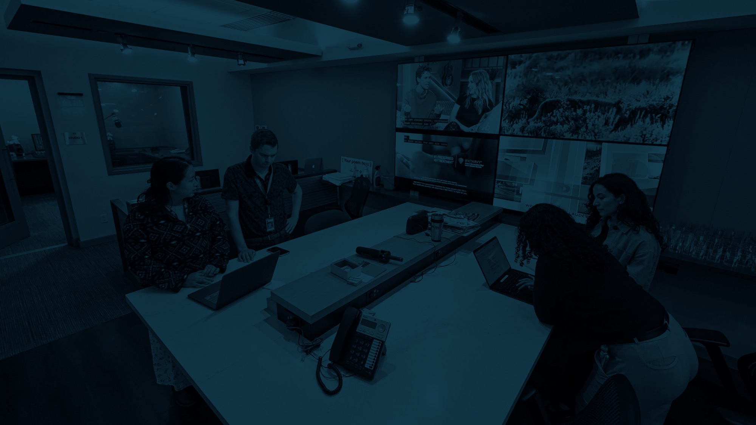

Common Challenges
Do people care about local news?
How do we explain our value?
What moves people to support local news?

Slide 3

How We Got Here
In-depth interviews with a mix of funders, newsrooms, and others
National public opinion survey including oversampling
Focus groups (3 identity-based and 6 location-based)
Message alignment focus groups with Press Forward stakeholders
Randomized control testing of core messages
Notes:
Blank slide

Slide 4


What We’ve Created
Notes:
Blank slide

Slide 5

Reframing the Local News Crisis

Slide 6

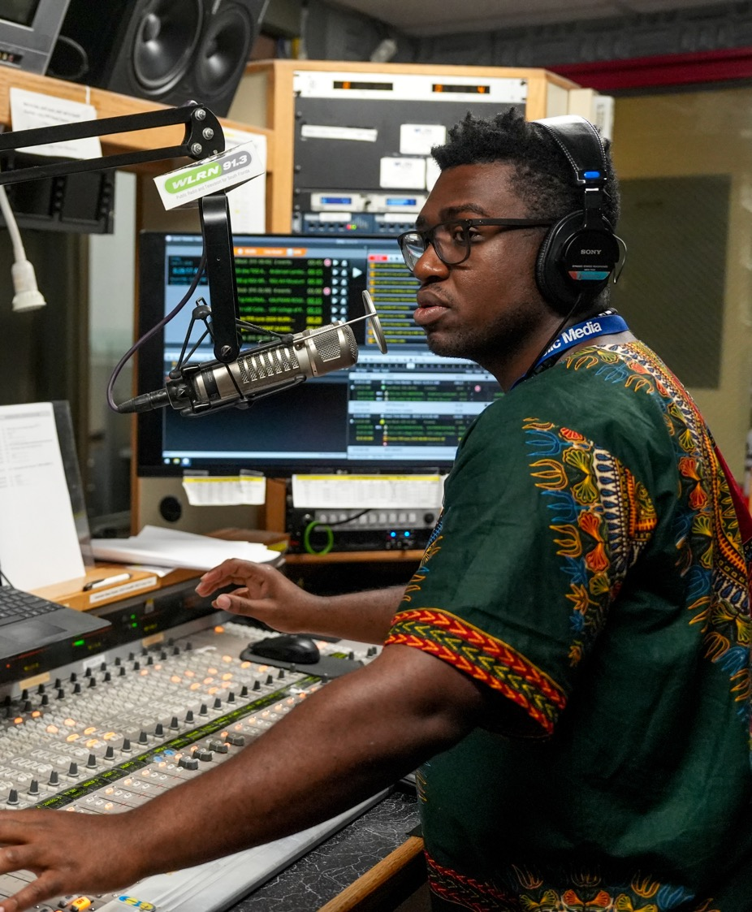
From Crisis to Community Benefit
Not This: "Save struggling journalism“ This: "Support trusted local news that strengthens our community"

Slide 7
Key Research Findings
More than eight in ten say they feel they can easily find and access trustworthy local news.
They cite local TV stations, social media, and community newspapers (physical, online, newsletter, or app) as their top sources of local news.
Nearly all (96%) believe that local news and information builds a stronger community.
70% prefer the term “local” to “community”, and “local news and information” is preferred to just “local news.”
Notes:
Blank slide

Slide 8


News Deserts (Y/N)?
Social media provides a constant stream of content.
Communities are not recognizing the absence because they’re not information-starved.
It’s about quality and trust, not quantity.
Negative framing is not motivating people to action.

Slide 9
What to Say Instead
Ensuring everyone has access to trustworthy, reliable community news
Connecting communities through shared stories and local perspectives
Local news as an accountability tool
Notes:
Blank slide

Slide 10
Research-Based Language Shifts
Lead with the strengths and opportunity – not news deserts.
"Local news and information" not "journalism"
“Community” works great – try “community connection” or “of the community”
Try not to frame as healthy/unhealthy.
News as a community connector and accountability tool.
Emphasis on practical outcomes — safety, accountability, participation
Notes:
Blank slide

Slide 11
Frames that Work
WIIFM: What’s In It For Me

Slide 12
Top Frames
Personal Relevance: Local news helps you make choices every single day.
Relational Trust Frame: You know the people behind your news.
Solutions-Oriented Frame: Shining a light on what’s working.
Accountability Frame: Someone needs to keep an eye on local institutions.
Crisis Response Frame: When there’s a crisis, local news is the lifeline.
Source Credibility Frame: Stronger news means a stronger community.
Objectivity Frame: Respects your ability to make up your own mind.

Slide 13
Frames that DON’T Work
Local news covers topics that I care about but don’t have time to follow
Local news gets me something unique that I can’t find anywhere else
Local news is good because I see familiar names, faces, or stories
Local news should affirm my political POV

Slide 14
Audience Quick Guide
Audience | What They Care About | Best Frame to Use
General Public | Daily Usefulness | Personal relevance
Rural Communities | Local voices they know | Relational trust
Conservatives | Preserving tradition, safety | Solutions-oriented
Progressives | Accountability, action | Democracy-based
Under 30 | Shareable, visual content | Personal relevance
Spanish Speakers | Family/community impact | Personal relevance
African Americans | Government accountability | Solutions-oriented
Notes:
Blank slide

Slide 15
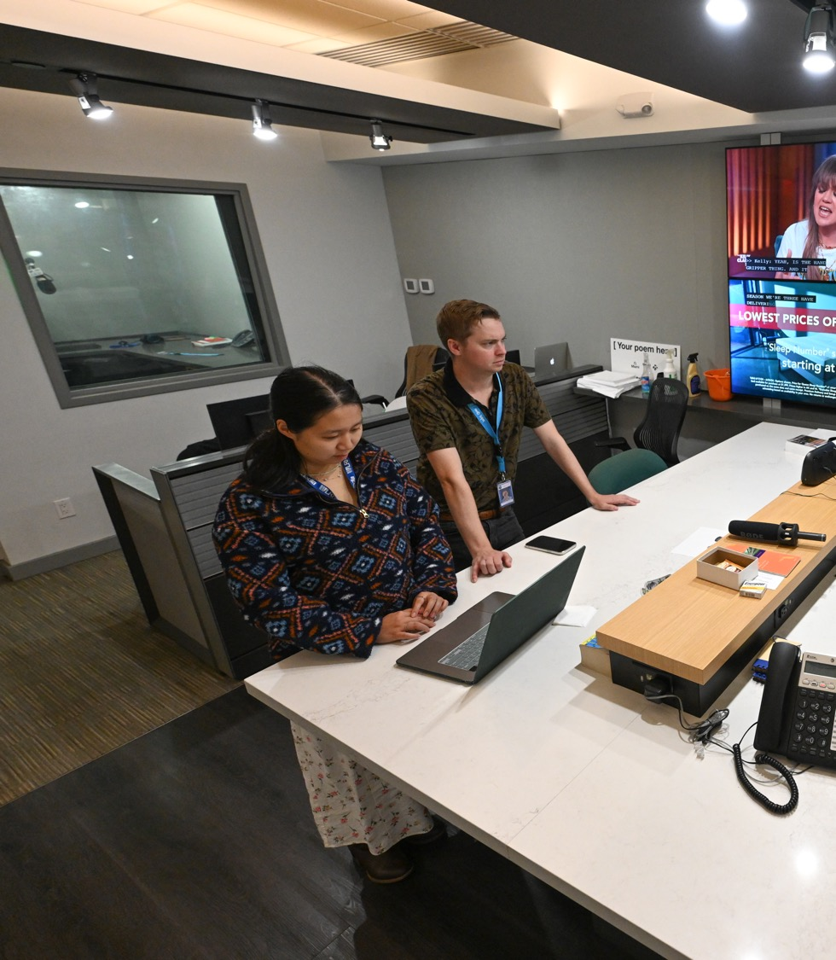
More on Democracy
Don’t avoid the concept – avoid the word.
Lead with concrete benefits people already value.
Let audiences make the democracy connection themselves.
Save explicit "democracy" language for already-engaged audiences and funders.

Slide 16
Example Democracy Reframe:
Instead of: "Local news protects democracy"
Try: "Local news keeps you informed about decisions affecting your taxes, schools, and safety"
Notes:
Blank slide

Slide 17
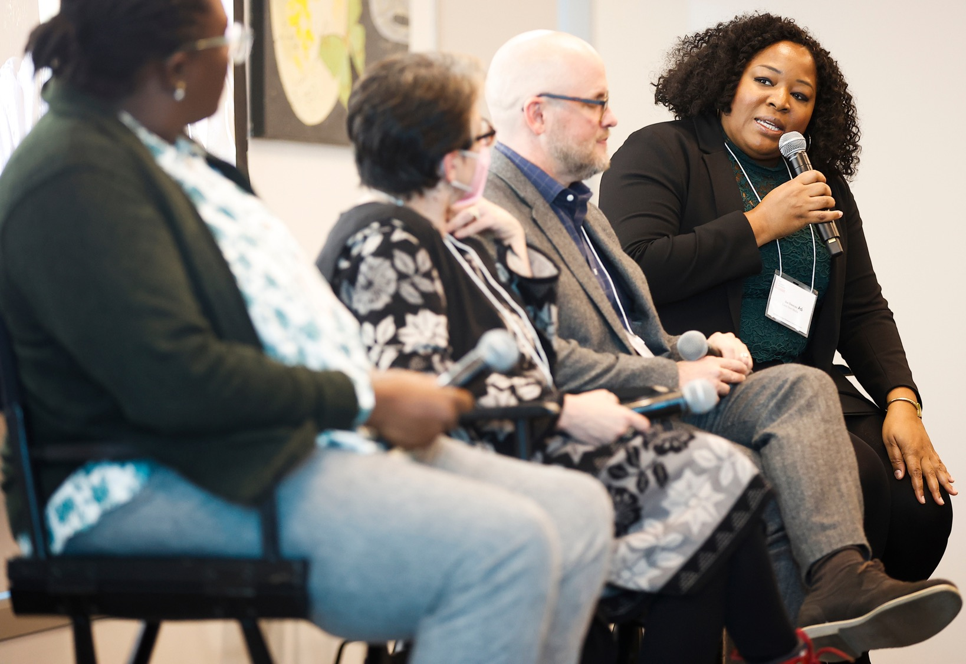
Why Not Journalism?
The gap isn’t about the work, it’s about the label. People value what journalists do, but the word has become politicized.
Journalism was associated with bias, opinion, or national politics even when respondents supported local news.
“Local news and information” and “local news” both tested better.

Slide 18
Journalism Reframe
Use “journalist” sparingly. If you do use it, anchor it in trust and accountability: “Our journalists live here too — their credibility depends on accuracy and fairness.”
When in doubt, pivot to phrases that tested well: local news, local information, community reporting, independent, fact-based, trustworthy, accountability.
For journalists, we’re advising that they lead with their function, not their title. Instead of “As journalists, we…,” try “Our job is to provide fact-based information you can use every day.”
Notes:
Blank slide

Slide 19
Talking About Your Impact
Lead with impact and usefulness – connect in to how your stories help people make decisions, stay safe, or stay connected.
Frame your work around community benefit by saying things like “Our reporting helped community members understand…”
When you can – show, don’t tell – what has changed or improved because of your work?
Notes:
Blank slide

Slide 20
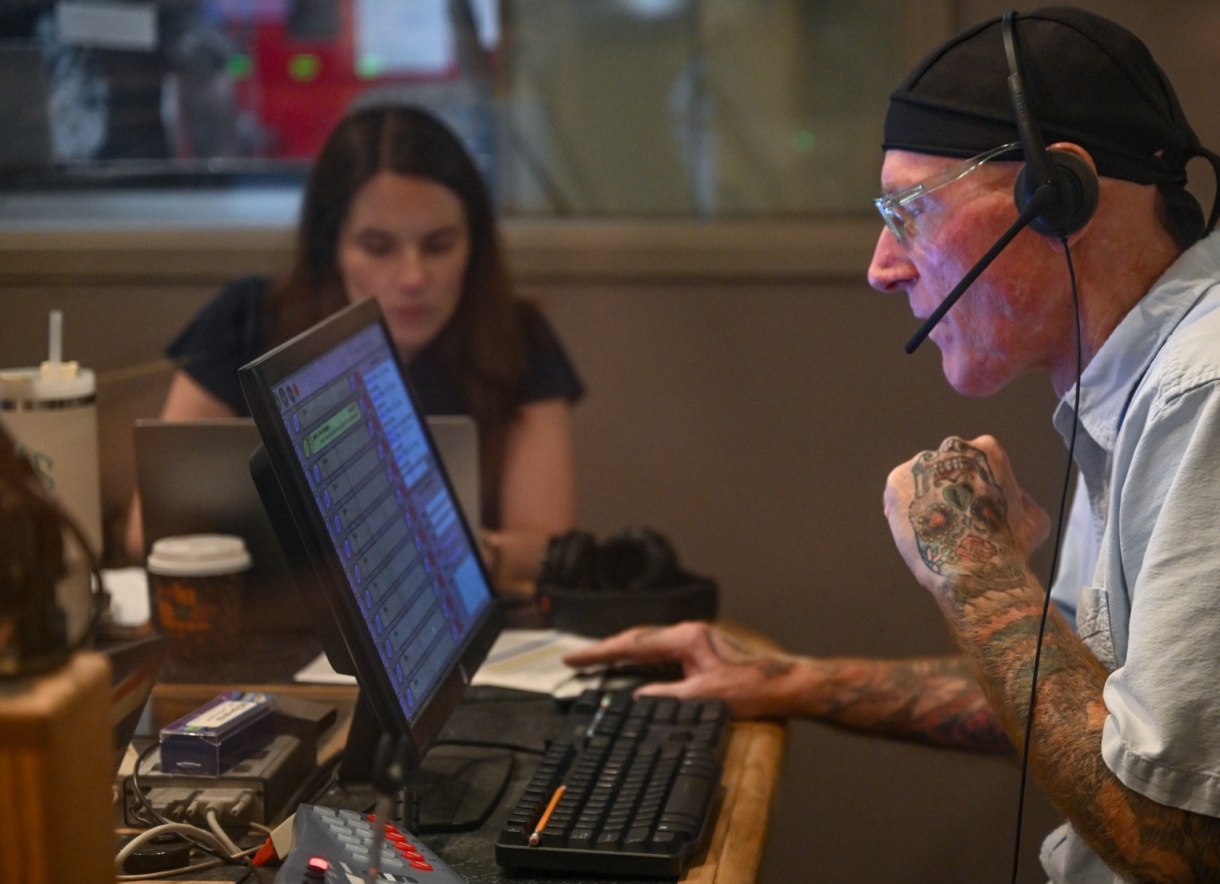
Talking About Local News
Local news connects people and strengthens communities.
Local news focuses on things that matter to you.
Local news is a public good
Support sustains service.
Local news keeps power accountable.

Slide 21
The Subscription Opportunity
Our research found that 70% of Americans say they are willing to pay for local news that they trust.
People subscribe when they:
Trust the source (top motivator)
See personal relevance to their daily life
Want to support their community
Value independent and fact-based reporting
Words that built trust: fact-based, independent, fair, trustworthy
Notes:
Blank slide

Slide 22
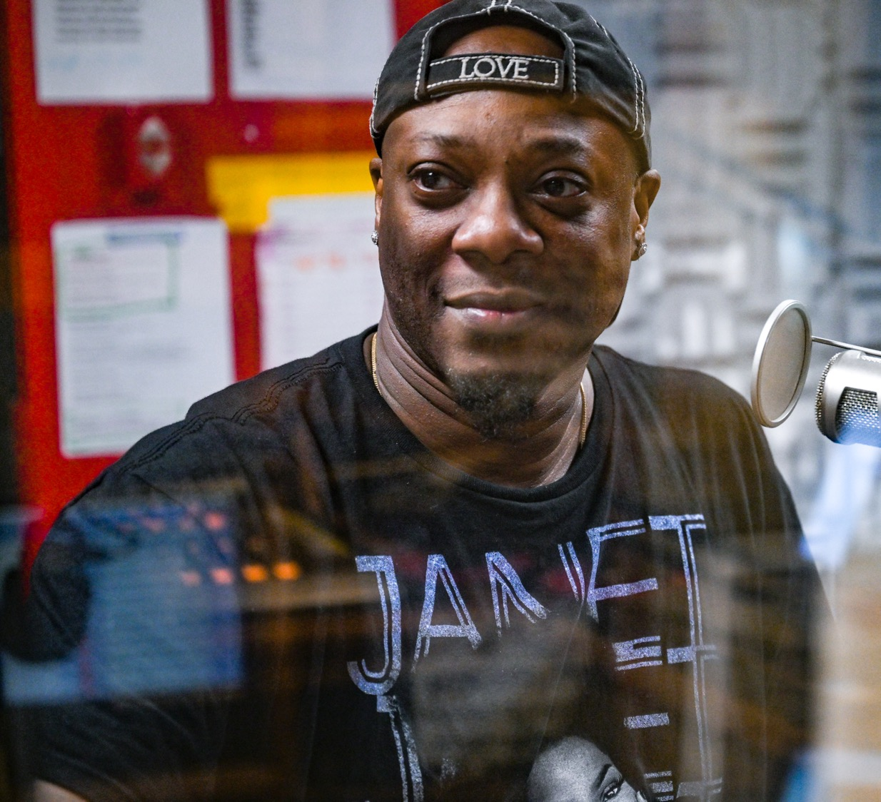
Making the Case for Support
Don’t lead with collapse. But you can use the crisis as context.
Balance urgency with agency. Give people an action to take.
Tailor your message for your unique audience.

Slide 23
Common Pitfalls & How to Avoid Them
PITFALL 1: Leading with Deficits
❌ "Local news is disappearing" ✅ “Local news strengthens communities.”
PITFALL 2: Using Jargon
❌ "We're addressing news deserts through hyperlocal solutions"
✅ "We're helping communities access the local information they need"
Notes:
Blank slide

Slide 24
Common Pitfalls & How to Avoid Them
PITFALL 3: Abstract Benefits*
❌ “Supporting democracy and civic engagement" ✅ “Local news helps you know what's happening at school board meetings and city council.”
PITFALL 4: Doom & Gloom
❌ "Without action, journalism will die”
✅ "With investment, communities can have thriving local news sources"
Notes:
Blank slide

Slide 25


